Slide 1

PhonePe Pulse Data Visualization (2018–2023)
Digital Payments • Transactions • Users • Geo Trends
NEERAJ KUMAR
Data Analyst Intern
LABMENTIX

Slide 2
Project Overview
🎯 Objective
  To analyze PhonePe digital payment trends across India
  Build an interactive Tableau dashboard
  Generate insights on transactions, users, device brands & geography
📊 Dataset
  Aggregated transactions
  Aggregated users
  District-level data
  State-level data
  Top states & districts

Slide 3
Dashboard Overview
Dashboard Contains:
  KPI Cards (Value, Transactions, Average Ticket, Users)
  Geo Visualization (State + District)
  Time-Series Trend Chart
  Top 10 States (Transactions & Users)
  Brand-wise User Distribution (TreeMap)
  Filters Panel (Year, Quarter, Brand, Trans Type, etc.)
🎯 Purpose:
  To understand growth patterns & payment adoption across India.

Slide 4
Key KPIs
📌 From 2018–2022:
  Total Value: ₹121.4T
  Total Transactions: 71,723.73M
  Average Ticket Size: ₹ 35,085
  Active Users: 4,702.02M
💡 Insights:
  Transaction volume is extremely high across India
  Larger values show rapid adoption of digital payments

Slide 5
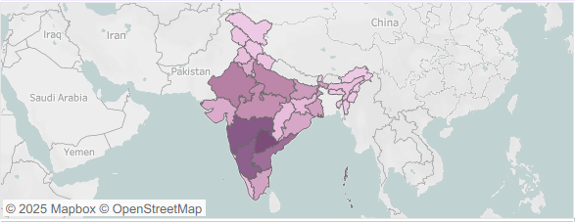
Geo Visualization (By State)
Top Performing States:
  Maharashtra
  Karnataka
  Telangana
  Tamil Nadu
💡 Insight:
  These states contribute the highest share of digital transactions.
  They also show the strongest YoY growth.

Slide 6
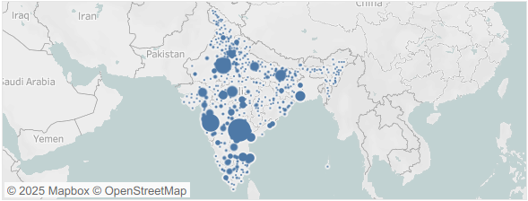
Geo Visualization (By District)
Districts with Highest Activity:
  Bengaluru (Urban)
  Hyderabad
  Chennai
  Mumbai Suburban
  Pune
💡 Insight:
  Tier-1 metro districts lead by a huge margin.
  Large bubble clusters in South India & Maharashtra show concentrated activity.

Slide 7
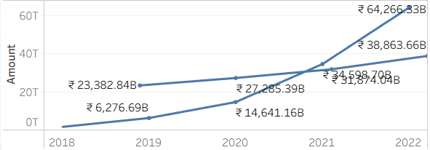
Time-Series Trend (2018–2022)
Trend Summary:
  Transactions grew from ₹6T → ₹64T (10X increase)
  Peak growth: 2020–2021 (Post-COVID acceleration)
  Growth momentum continues in 2022
💡 Insight:
  Digital payments saw a 10X growth within 5 years, showing India’s rapid fintech revolution.

Slide 8
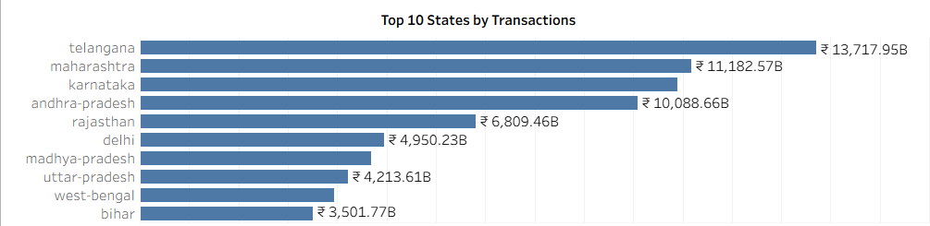
Top 10 States by Transactions
📌 Top States:
  Telangana
  Maharashtra
  Karnataka
  Andhra Pradesh
  Rajasthan
💡 Insight:
  Southern states dominate PhonePe usage due to:
  Tech-savvy population
  Better digital infrastructure
  High UPI adoption

Slide 9
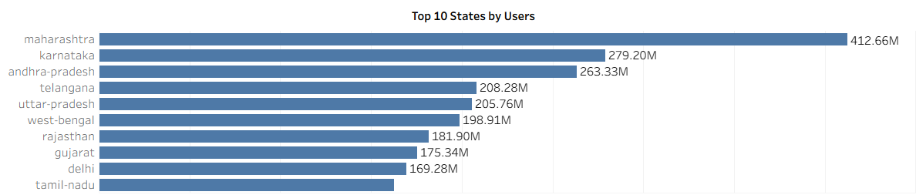
Top 10 States by Users
📌 Top States:
  Maharashtra
  Karnataka
  Andhra Pradesh
  Telangana
  Uttar Pradesh
💡 Insight:
While South India leads in transactions,
population-heavy states like UP & Rajasthan show high user counts (but lower transaction value).

Slide 10
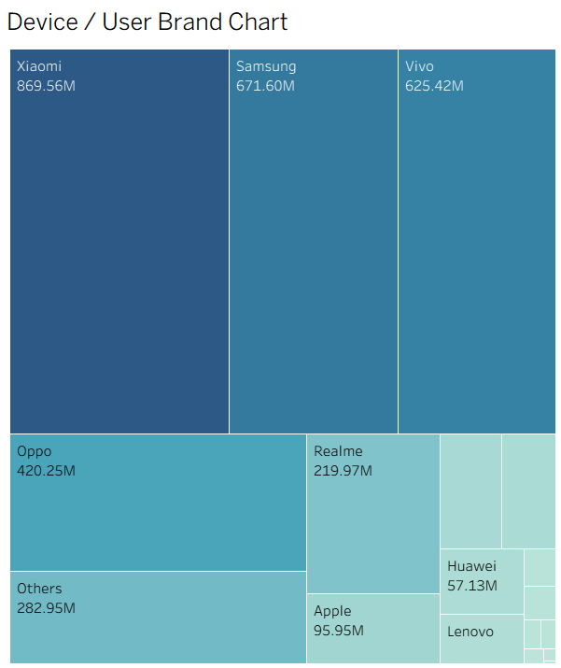
Brand-wise Device Share
📲 Top Smartphone Brands:
  Xiaomi (highest market share)
  Samsung
  Vivo
  Oppo
  Apple
  Others
💡 Insight:
  Majority of PhonePe users are on mid-range Android devices,
  indicating strong adoption in middle-income user groups.

Slide 11
Key Insights Summary
India’s digital payments grew 10X from 2018–2022.
South India leads in both value & volume.
Metro districts are the strongest contributors.
UPI adoption accelerated post-2020.
Xiaomi & Samsung dominate user device share.
India shows strong digital readiness & fintech penetration.

Slide 12
Business Recommendations
Expand merchant acceptance in Tier-2 & Tier-3 cities
Run user acquisition campaigns in UP, Rajasthan, Bihar
Strengthen partnerships with smartphone brands (Xiaomi & Samsung)
Add localized language support for regional penetration
Incentivize first-time digital payment users

Slide 13
Conclusion
India is experiencing unprecedented digital payment growth
PhonePe plays a major role in accelerating UPI adoption
Insights show strong national penetration
Future growth will come from semi-urban & rural regions

Slide 14
THANK YOU

